Slide 1



PET ME!
PET ME!
ITCS335_Introduction To
E-Business Systems
2/2021

Slide 2
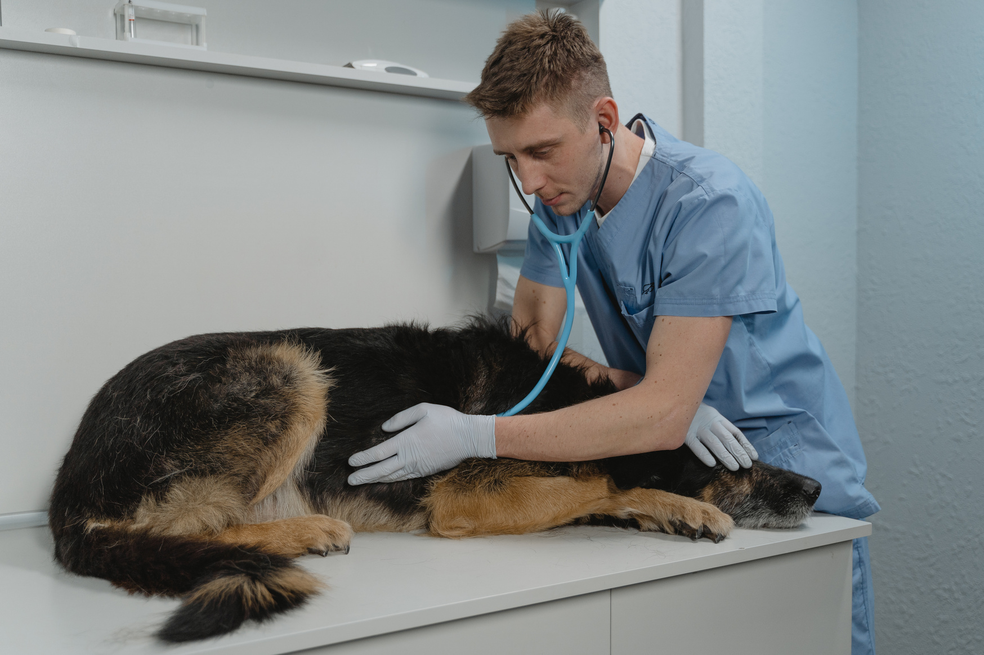
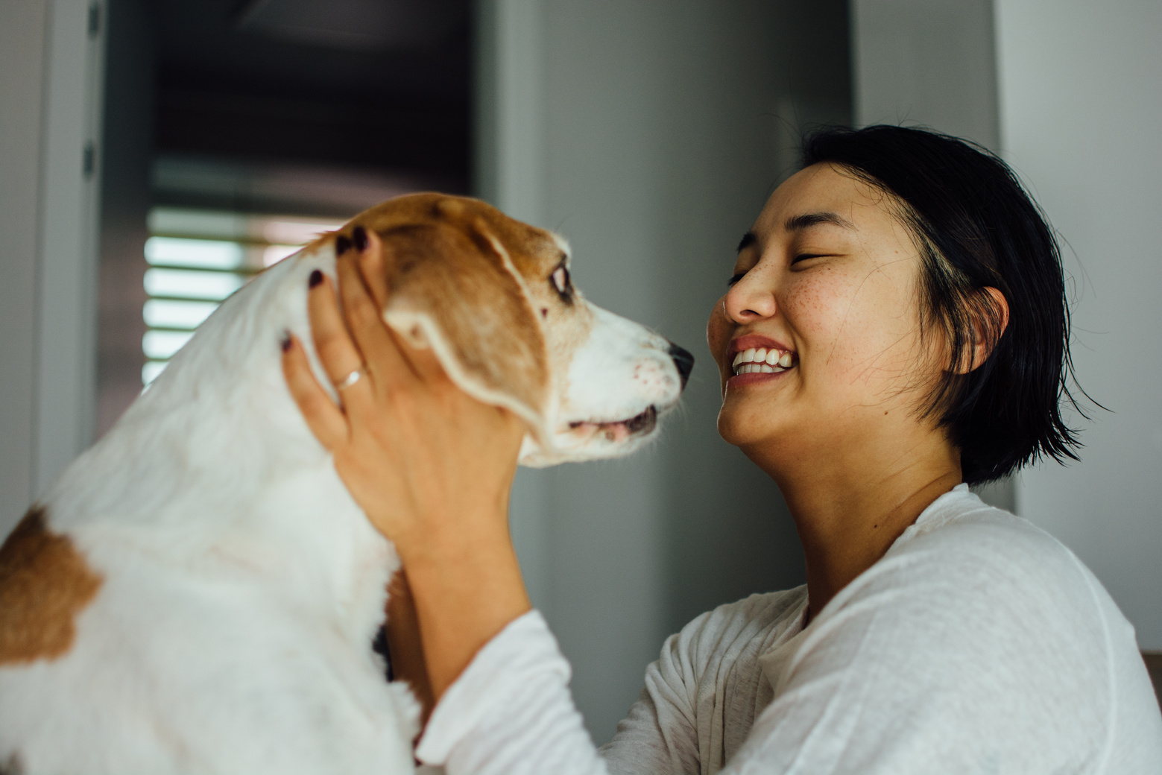
Let's get to know
Pet ME!
PET ME!
PET ME! the best for pets lover
Want to provide complete care for your pet and get your pet to the vet easily and conveniently with a certain appointment time?
01
ITCS335_Introduction To E-Business Systems
2/2021

Slide 3
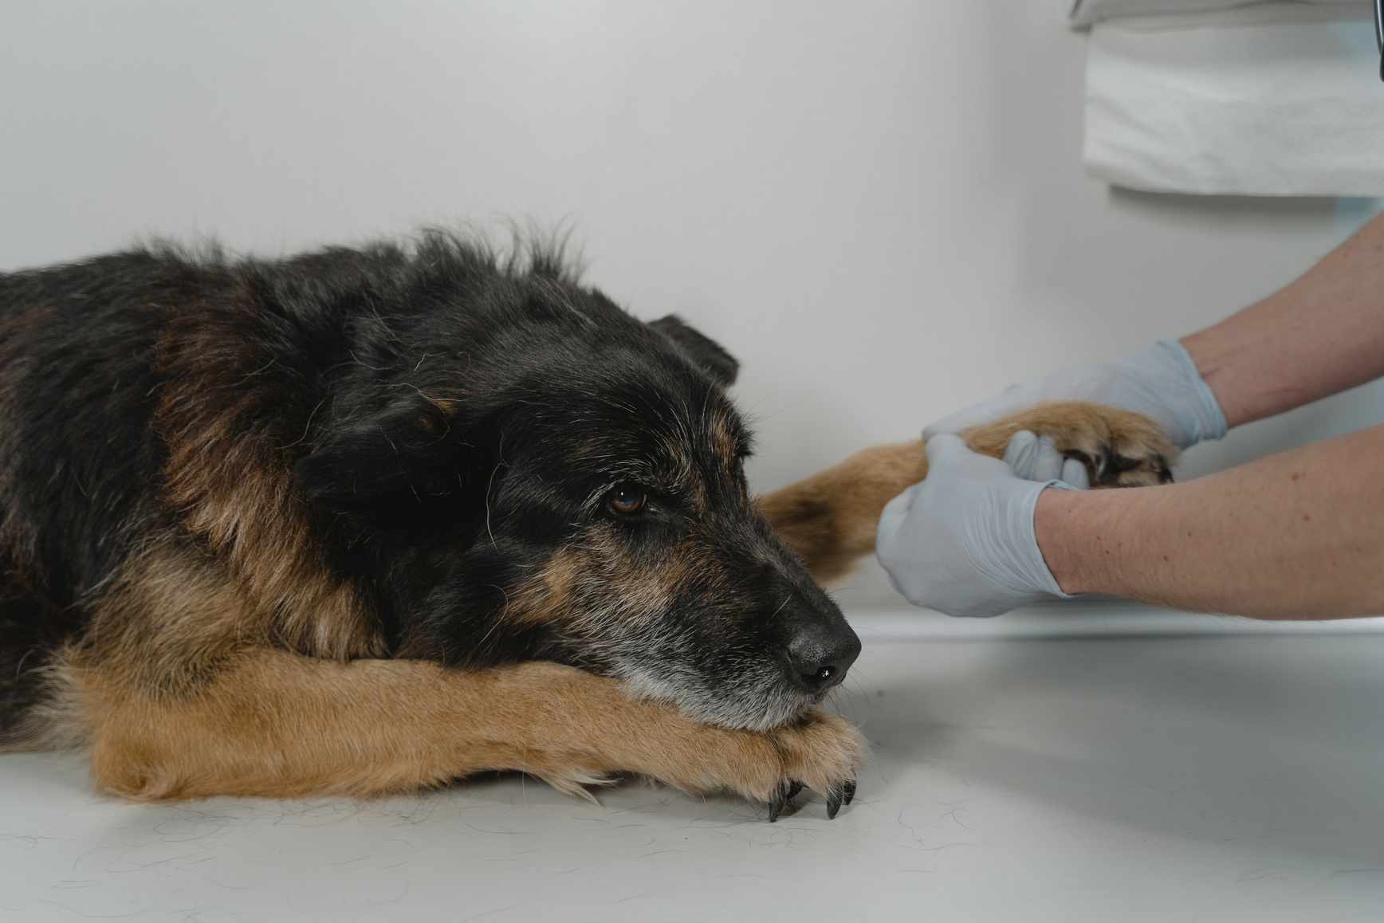
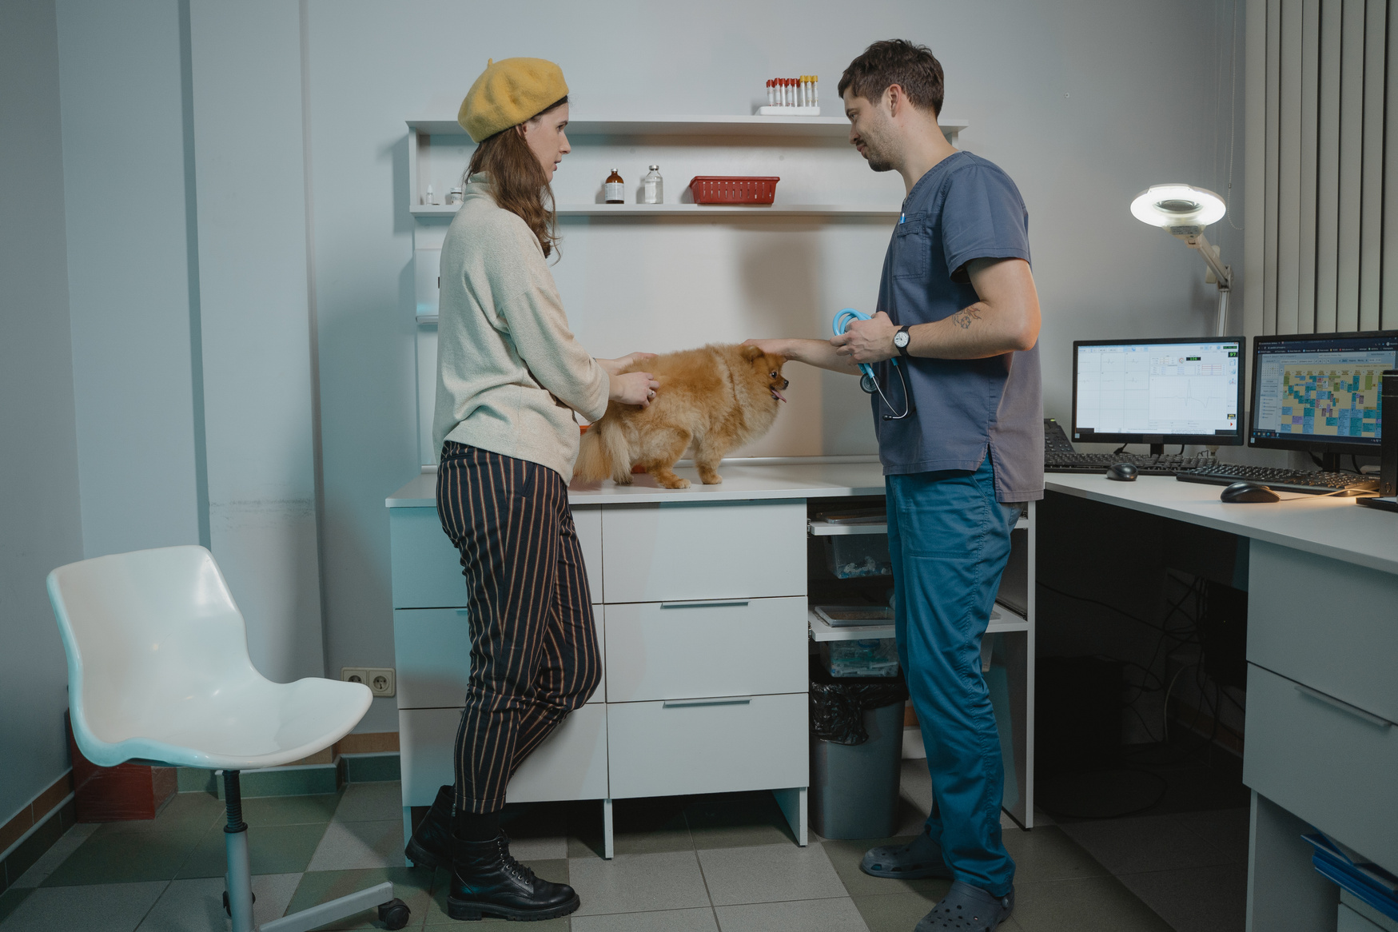
Problems
PET ME!
Customer's Pain
Here is examples of customer's common pain that we found from the questionnaire
Wasting of time
Veterinarian's queue is not available
Anxiety during Covid-19 situation
Had to go early in the morning to wait in line and had to sit and wait for the vet for hours.
Sometimes pet owner didn't go on time, so vet's queue is not available
According to a survey, most animal owners feel uncomfortable having to wait in long queues during COVID-19.
ITCS335_Introduction To E-Business Systems
02
2/2021

Slide 4
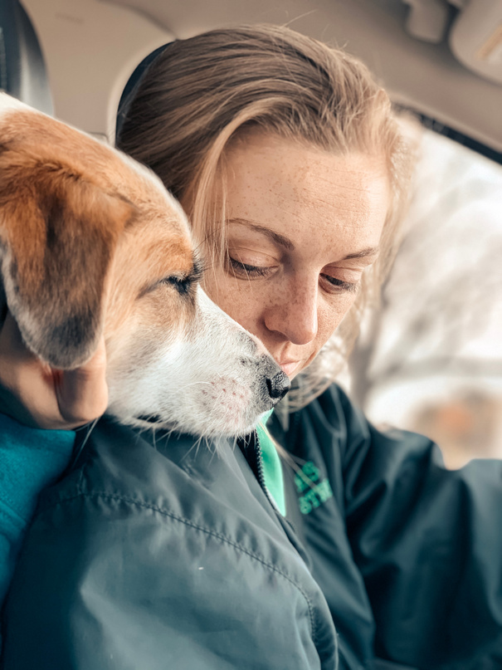

Description
Pain
PET ME!
Cindy's dog has a very serious food allergy symptom. She used to take her dog to the hospital but during the covid-19 situation, She was very anxious about it and didn't want to waste time waiting in line. So she wanted to take her dog to the vet at a certain time to avoid the crowds.
Veterinarian's queue is not available
Didn't have much time to wait in line.
Worried about the covid situation
Pet's Owner
Target Market
Goal
Expectation
Cindy B.
Want to take her dog to the vet at an exact time to avoid crowds.
Save time
convenient
Customer Persona
Age: 23
Location: Silom
Needs
looking for online consultation with a vet for pet.
looking for a service that can book an appointment in advance with a veterinarian at an exact time.
ITCS335_Introduction To E-Business Systems
03
2/2021

Slide 5




26-30
3.5%
20-25
36.8%
10-19
26-30
20-25
10-19
59.6%
40+
CUSTOMER AGE GROUPS

Slide 6



Yes, I have
40.4%
No, I don't have
No, I don't have
59.6%
Yes, I have
HAVE YOU EVER BOOKED AN APPOINTMENT WITH A VETERINARIAN IN ADVANCE?

Slide 7



Uncomfortable
25%
Waste of time
50%
Uncomfortable
Indifferent
Waste of time
Indifferent
25%
HOW DO YOU FEEL IF YOU HAVE TO WAIT IN QUEUE FOR TREATMENT FOR A LONG TIME DURING COVID-19?

Slide 8
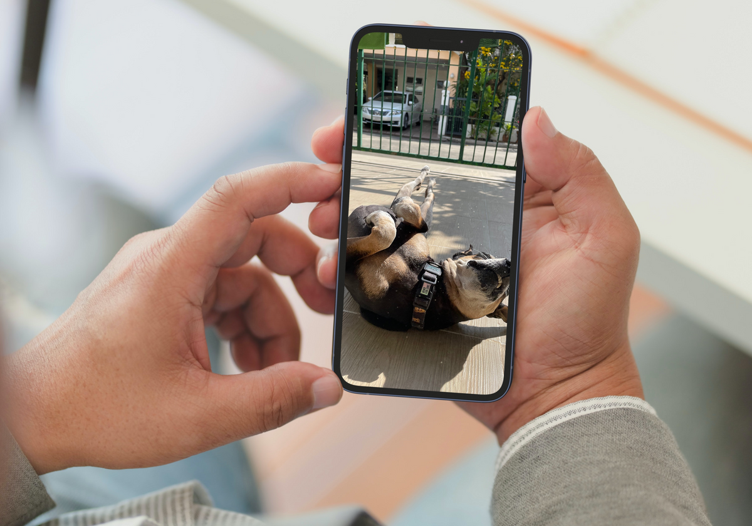
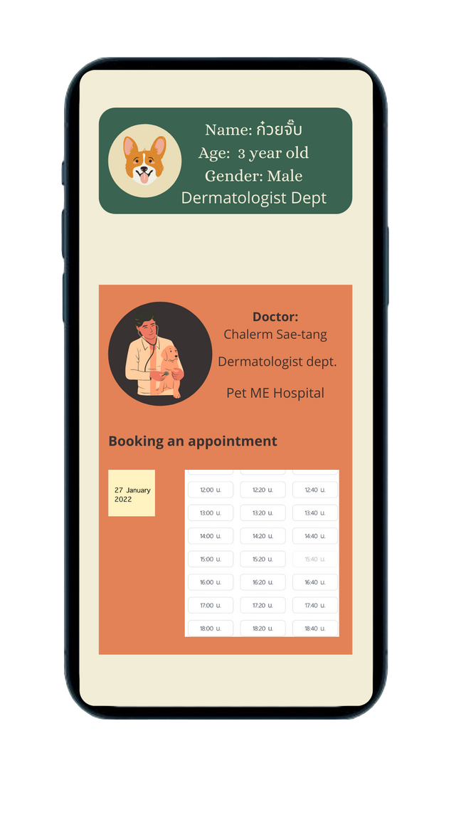

Solutions
PET ME!
Our solutions
PET ME! has created one function for users (pet owners) to book an appointment in advance with a veterinarian and with hospitals or clinics in which they are interested where they want to take their pets will be treated and be able to select a time that is convenient for users.
Faster and comfortable
Reduce time of waiting queue
Easy to use
UI of application is easy to use
Safely
It has been proven that seeing
a professional doctor is completely safe
ITCS335_Introduction To E-Business Systems
07
2/2021

Slide 9




PET ME! Features
PET ME!
Pet friendly transportation
Shopping
select driver to travel to their destination with their pets whether hospital or other place with a delicious snack for their pets.
We provide pet supplies to choose the best and most comprehensive products for their pets.
Hospital appointment
Veterinarian's online consultation
PET ME! has cooperate with veterinarians, hospital, and clinics to allow users (pet owners) be able to ​view profile of each veterinarian's education and treatment records. So, they can book an appointment in advance in their convenient time.
similar with ‘Hospital’ function but difference is that this ‘Online consulting’ is basically a general treatment that focuses on pet behavior problems.
select whether animal trainers and veterinarians by using our video call mode which costs 150 baht per 15 minutes.
ITCS335_Introduction To E-Business Systems
08
2/2021

Slide 10
Revenue Model
PET ME!
The hospital or clinic side will have to pay the queue fee to our company in the amount of 15%
Online consultation
20%
Hospital
20%
The income on Veterinarians and Pet trainers will be deducted as the commission for the company in amount of 15%.
Driver will receive fare which already deducted in amount of 15% as a commission
Shopping
20%
Transportation
20%
We get a monthly commission from those shops and contracts for them
Advertising
20%
The fee is charged monthly with a contract signed
ITCS335_Introduction To E-Business Systems
09
2/2021

Slide 11





Competitor of Pet ME!
PET ME!
S.O. Pet
Pet First Aid
PetBacker:
Dog Cat Pet Sitting
Baanlaesuan PETs
VitusVet Pet Medical Records
10
ITCS335_Introduction To E-Business Systems
2/2021

Slide 12

COMPETITOR ANALYSIS
PET ME!
Features
PET ME!
Baanlaesuan
PETs
S.O. Pet
Pet backer:
dog cat
Pet sitting
VitusVet
Pet Medial
Records
Pet
FirstAid
Book an
Appointment
In advance
Online consultation
Shopping
Transportation
New and
Articles
Available on IOS
11
ITCS335_Introduction To E-Business Systems
2/2021

Slide 13
BUSINESS MODEL CANVAS
PET ME!
KEY PARTNERS
KEY ACTIVITIES
VALUE PROPOSITION
CUSTOMER RELATIONSHIP
CUSTOMER SEGMENTS
Low cost
Safety
Problem-solving
Improving user's experience
Call center
Promotion and discount coupon
Online inquiry
Dedicated personal
assistance
Veterinary Hospitals
Local Veterinary Clinics
Veterinarians
(Online Consultation)
Grab Taxi
Vetinter Group
Inter Vetta
BIC CHEMICAL Cp., LTD.
Greastest Pet Care Co., Ltd.
Tailand Corporation Co., Ltd.
Wannarak Enterprise Co., Ltd.
ANIMAL-GO-ROUND CO., Ltd.
Schedule hospital appointment
Online Consultation
Processing order
Pet owners
Pet lovers
KEY RESOURCES
CHANNELS
Veterinary Hospitals
Veterinary Clinics
Veterinarians
Taxi
Pet food suppliers
Pet medical suppliers
Pet accessory suppliers
Pet equipment suppliers
E-commerce
Application
Word of mouth
Social Media
COST STRUCTURE
REVENUE STREAMS
Brokerage fee
Free
Platform and Application development
Software Maintenance
12
ITCS335_Introduction To E-Business Systems
2/2021

Slide 14
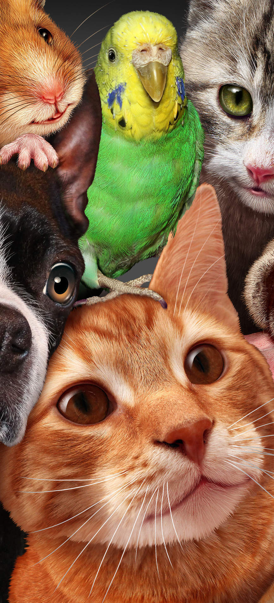
Strengths
PET ME!
S
PET ME! can schedule a vet appointment in advance.
PET ME! has a full range of features and is comprehensive for pet care.
There are discounts and promotions for in-app expenses.
Weaknesses
W
Some hospitals may not accept patients through our app since they can already make a profit by themselves.
Some users don't need to use our app because they live near a veterinary clinic, so they call them to treat their pets at home.
13
ITCS335_Introduction To E-Business Systems
2/2021

Slide 15
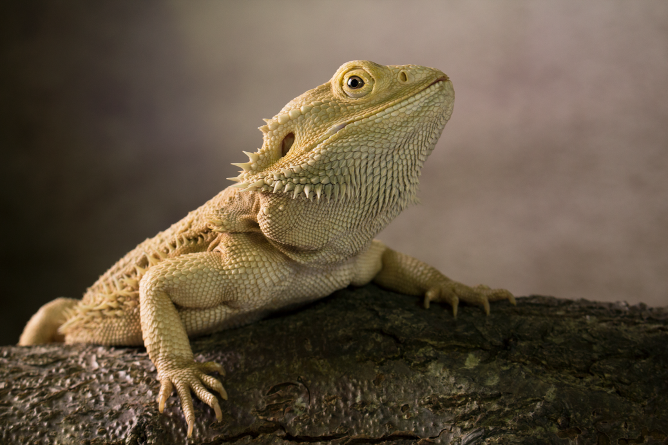
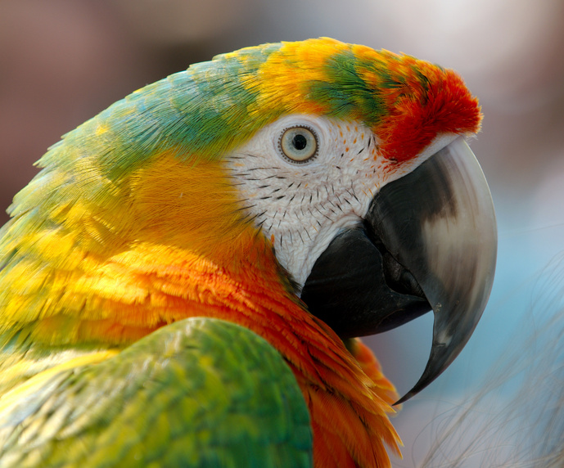
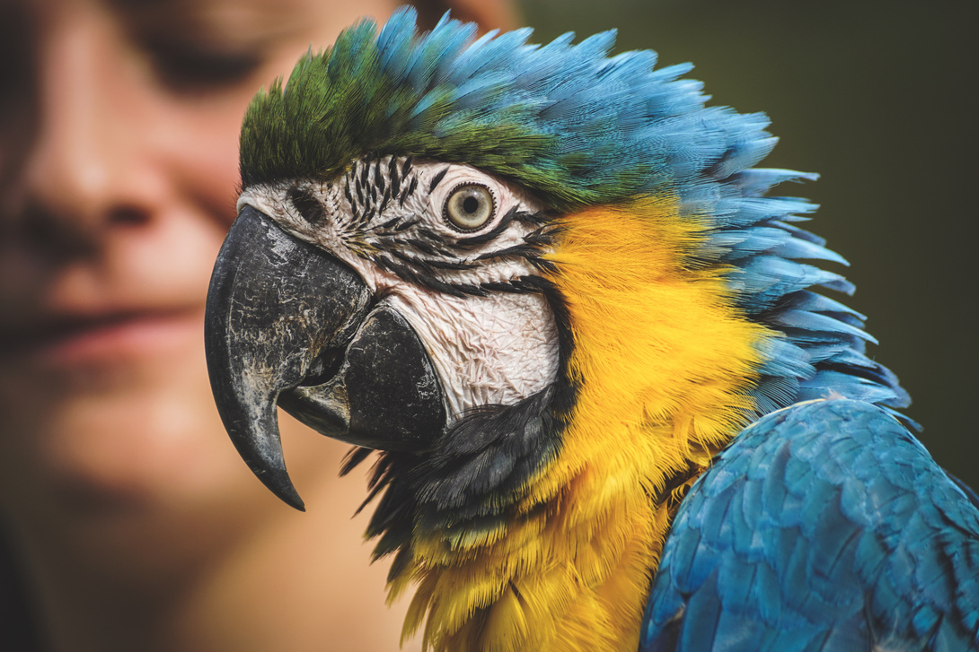
Opportunities
PET ME!
O
The number of people who have pets has increased dramatically in recent years.
The average annual number of veterinarian visits per family is high.
Threats
T
Cost increases, there is always the possibility that business and material costs will rise.
In the pet equipment market, there is a lot of competition.
14
ITCS335_Introduction To E-Business Systems
2/2021

Slide 16





Our Team
PET ME!
Waris Damkham
Suphawit Xu
Pattanan Korkiattrakool
Wattanapong Sukchareonchok
Phumtham Akkarasiriwong
6388014
6388078
6388022
6388197
6388001
ITCS335_Introduction To E-Business Systems
15
2/2021

Slide 17

Thank You
Q&A

